Slide 1
Comparison of AWS, Azure, and GCP
A general overview of the three major cloud providers

Slide 2
AWS Overview
What is Cloud Computing?
Cloud computing is the on-demand delivery of computing resources (like servers, storage, databases, networking, software, and more) over the internet. Instead of owning physical infrastructure, users can rent computing power and services from cloud providers such as AWS, Azure, and GCP.
Key Characteristics of Cloud Computing
On-Demand Self-Service – Users can access computing resources without human intervention.
Broad Network Access – Services are accessible over the internet from anywhere.
Scalability – Resources can be scaled up or down based on demand.
Resource Pooling – Multiple users share computing resources efficiently.
Measured Service – Pay for what you use (pay-as-you-go pricing).

Slide 3
AWS Overview
- Oldest and most established cloud provider
- Launched in 2006
- Offers a wide range of services including:
• Compute
• Storage
• Databases
• Machine Learning
• IoT capabilities
- Most popular cloud provider with largest market share

Slide 4
Microsoft Azure Overview
- Launched in 2010
- Offers similar services to AWS:
• Compute
• Storage
• Databases
- Strong focus on hybrid cloud capabilities
- Allows easy connection of on-premise infrastructure with Azure services
- Strong integration with Microsoft products (Office 365, Dynamics 365)

Slide 5
Google Cloud Platform (GCP) Overview
- Launched in 2011, one year after Azure
- Offers similar services to AWS and Azure:
• Compute
• Storage
• Databases
- Strong focus on big data and machine learning
- Uses TensorFlow and BigQuery for AI and analytics
- Integrates well with Google services like Google Analytics and Google Maps

Slide 6
Comparison: Pricing & Services
- AWS: Most comprehensive service offering with many products
- Azure: Comes in second with a wide selection of services
- GCP: More focused on developers and startups with a smaller range of services

Slide 7
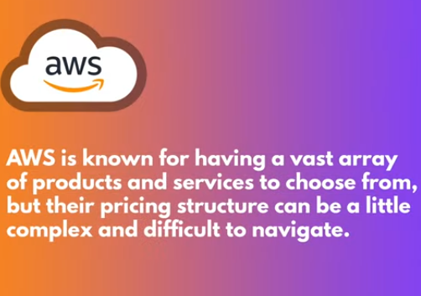
Comparison: Pricing & Services

Slide 8
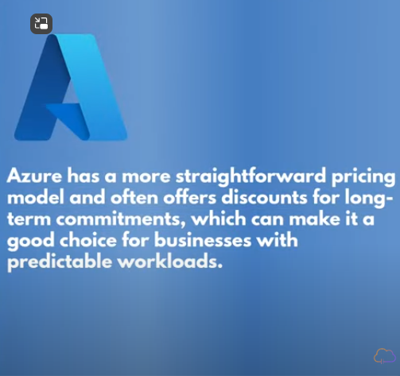
Comparison: Pricing & Services

Slide 9
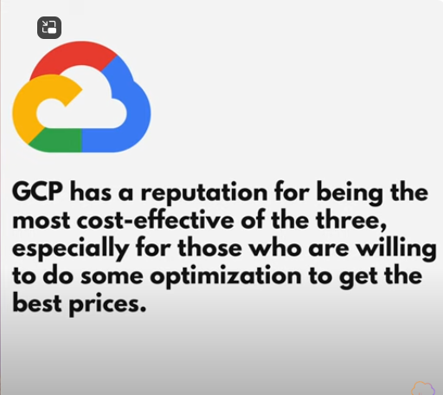
Comparison: Pricing & Services

Slide 10
Comparison: Web Console
- AWS: Comprehensive but complex, highly customizable, harder to navigate
- Azure: More intuitive and user-friendly, streamlined interface
- GCP: Easier to start with, clean and simple UI

Slide 11
Comparison: Database Services
- AWS: Offers fully managed database services
- Azure: Similar offerings to AWS with Azure SQL and Cosmos DB
- GCP: Provides Cloud SQL, Cloud Spanner, and Bigtable for managed databases

Slide 12
Strengths of Each Cloud Provider
- AWS: Reliability and innovation
- Azure: Strong in AI and machine learning
- GCP: More open and developer-friendly

